Slide 1
Azure Automated Machine Learning

Slide 2
What is automated machine learning?
The Azure Machine Learning service can automatically pick an algorithm, and generate a model from it. Automated machine learning helps save you time by using the parameters and criteria you provide to select the best algorithm for your model.

Slide 3






How it works?
Input
Automated Machine Learning
Output
Algorithm-1
Hyperparameter-1
Hyperparameter-2
Hyperparameter-n
Dataset
Algorithm-2
Hyperparameter-1
Hyperparameter-2
.
.
.
.
Hyperparameter-n
Configuration of Workspace Credentials
Deploy the Best Model
Algorithm-n
Hyperparameter-1
Hyperparameter-2
Hyperparameter-n
Configuration Of AutoML
Use it for further Predictions

Slide 4
How to configure and use Azure Automated ML

Slide 5
Steps to run Automated ML
Pre-requisites
Create a workspace and its configuration file (config.json)
Install Anaconda Jupyter Notebook
Steps (Create a new Jupyter Notebook to work on)
Step 1 – Configure workspace
Step 2 – Import and Explore the Dataset
Step 3 – Configure your automated machine learning experiment
Step 4 – Submit your Experiment
Step 5 – Review Results
Step 6 – Deploy the Best Model

Slide 6
Create a workspace and its configuration file (config.json)
Create a Workspace in Azure Portal
Copy the subscription Id, resource_group and workspace_name and save it in a json format
Save this json format file in the same directory with the Jupyter Notebook
{
"subscription_id": " subscription_id ",
"resource_group": " resource_group ",
"workspace_name": " workspace_name "
}

Slide 7
Step – 1 Configure workspace
Create a Jupyter Note book
Create a workspace object from the existing workspace. reads the file aml_config/config.json and loads the details into an object named . is used throughout the rest of the code in this tutorial.
Once you have a workspace object, specify a name for the experiment and create and register a local directory with the workspace. The history of all runs is recorded under the specified experiment.
Workspace.from_config()
ws
ws
ws = Workspace.from_config()
experiment_name = ‘experiment_name'
project_folder = ‘./project_folder_name'
Check your Workspace configurations
import os
output = {}
output['SDK version'] = azureml.core.VERSION
output['Subscription ID'] = ws.subscription_id
output['Workspace'] = ws.name
output['Resource Group'] = ws.resource_group
output['Location'] = ws.location
output['Project Directory'] = project_folder
pd.set_option('display.max_colwidth', -1)
pd.DataFrame(data=output, index=['']).T

Slide 8
Step – 2 Import and Explore the Dataset
Automated ML supports data that resides on your local desktop or in the cloud in Azure Blob Storage. The data can be read into scikit-learn supported data formats. You need to convert the data into any of the following format:
NumPy arrays
Pandas data frame.
X will be the (features) and y will be the (target variable or also known as label).
For Classification Problems the Target variable should always be numerical.
import pandas as pd
data = pd.read_csv(‘yourdataset.csv')

Slide 9
Step – 3 Configure your automated machine learning experiment
Select Your Experiment Type
Automated ML supports two categories of supervised learning: Classification and Regression. Automated ML supports the following algorithms during the automation and tuning process. As a user, there is no need for you to specify the algorithm.
Classification | Regression
sklearn.linear_model.LogisticRegression | sklearn.linear_model.ElasticNet
sklearn.linear_model.SGDClassifier | sklearn.ensemble.GradientBoostingRegressor
sklearn.naive_bayes.BernoulliNB | sklearn.tree.DecisionTreeRegressor
sklearn.naive_bayes.MultinomialNB | sklearn.neighbors.KNeighborsRegressor
sklearn.svm.SVC | sklearn.linear_model.LassoLars
sklearn.svm.LinearSVC | sklearn.linear_model.SGDRegressor
sklearn.calibration.CalibratedClassifierCV | sklearn.ensemble.RandomForestRegressor
sklearn.neighbors.KNeighborsClassifier | sklearn.ensemble.ExtraTreesRegressor
sklearn.tree.DecisionTreeClassifier | lightgbm.LGBMRegressor

Slide 10
Parameters for Automated ML experiment settings
Property | Description | Default Value
task | Specify the type of machine learning problem. Allowed values are · classification · regression | None
primary_metric | Metric that you want to optimize in building your model. For example, if you specify accuracy as the primary_metric, Automated ML looks to find a model with maximum accuracy. You can only specify one primary_metric per experiment. Allowed values are Classification: · accuracy · AUC_weighted · precision_score_weighted · balanced_accuracy · average_precision_score_weighted Regression: · normalized_mean_absolute_error · spearman_correlation · normalized_root_mean_squared_error · normalized_root_mean_squared_log_error · R2_score | For Classification: accuracy For Regression: spearman_correlation

Slide 11
Parameters for Automated ML experiment settings
Property | Description | Default Value
exit_score | You can set a target value for your primary_metric. Once a model is found that meets the primary_metric target, Automated ML will stop iterating and the experiment terminates. If this value is not set (default), Automated ML experiment will continue to run the number of iterations specified in iterations. Takes a double value. If the target never reaches, then Automated ML will continue until it reaches the number of iterations specified in iterations. | None
iterations | Maximum number of iterations. Each iteration is equal to a training job that results in a pipeline. Pipeline is data preprocessing and model. To get a high-quality model use 250 or more | 100
Concurrent_iterations | Max number of iterations to be run in parallel. This setting works only for remote compute. | 1
max_cores_per_iteration | Indicates how many cores on the compute target would be used to train a single pipeline. If the algorithm can leverage multiple cores, then this increases the performance on a multi-core machine. You can set it to -1 to use all the cores available on the machine. | 1
max_time_sec | Limits the amount of time (seconds) a particular iteration takes. If an iteration exceeds the specified amount, that iteration gets canceled. If not set, then the iteration continues to run until it is finished. | None

Slide 12
Parameters for Automated ML experiment settings
Property | Description | Default Value
n_cross_validations | Number of cross validation splits | None
validation_size | Size of validation set as percentage of all training sample. | None
preprocess | True/False True enables experiment to perform preprocessing on the input. Following is a subset of preprocessing · Missing Data: Imputes the missing data- Numberical with Average, Text with most occurance · Categorical Values: If data type is numeric and number of unique values is less than 5 percent, Converts into one-hot encoding Note : if data is sparse you cannot use preprocess = true | False
verbosity | Controls the level of logging with INFO being the most verbose and CRITICAL being the least. Allowed values are: · logging.INFO · logging.WARNING · logging.ERROR · logging.CRITICAL | logging.INFO
X | All features to train with | None
y | Label data to train with. For classification, should be an array of integers. | None

Slide 13
Parameters for Automated ML experiment settings
Property | Description | Default Value
blacklist_algos | Automated ML experiment has many different algorithms that it tries. Configure Automated ML to exclude certain algorithms from the experiment. Useful if you are aware that algorithm(s) do not work well for your dataset. Excluding algorithms can save you compute resources and training time. | None
Allowed values for Classification | Allowed values for Regression
logistic regression | Elastic net
SGD classifier | Gradient boosting regressor
MultinomialNB | DT regressor
BernoulliNB | kNN regressor
SVM | Lasso lars
LinearSVM | SGD regressor
kNN | RF regressor
DT | extra trees regressor
RF
extra trees
gradient boosting
lgbm_classifier

Slide 14
Parameters for Automated ML experiment settings
Property | Description | Default Value
X_valid | Optional All features to validate with. If not specified, X is split between train and validate | None
y_valid | Optional The label data to validate with. If not specified, y is split between train and validate | None
sample_weight | Optional A weight value for each sample. Use when you would like to assign different weights for your data points | None
sample_weight_valid | Optional A weight value for each validation sample. If not specified, sample_weight is split between train and validate | None
run_configuration | RunConfiguration object. Used for remote runs. | None
data_script | Path to a file containing the get_data method. Required for remote runs. | None

Slide 15
Some of the examples of Configuration of your experiment settings
There are several knobs that you can use to configure your automated ML experiment. These parameters are set by instantiating an AutoMLConfig object.
Some examples include:
1. Classification experiment using AUC weighted as the primary metric with a max time of 12,000 seconds per iteration, with the experiment to end after 50 iterations and 2 cross validation folds.
2. Below is an example of a regression experiment set to end after 100 iterations, with each iteration lasting up to 600 seconds with 5 validation cross folds.
from azureml.train.automl import AutoMLConfig
Automl_config = AutoMLConfig(
task=‘classification’,
primary_metric = ‘AUC_weighted’,
max_time_sec = 12000,
iterations=20,
X = X,
y = y,
n_cross_validations = 2)
from azureml.train.automl import AutoMLConfig
Automl_config = AutoMLConfig(task = 'regression',
primary_metric = 'normalized_root_mean_squared_error',
max_time_sec = 600,
iterations = 5,
preprocess=True,
n_cross_validations = 3,
X = X_train,
y = y_train,
path=project_folder)

Slide 16
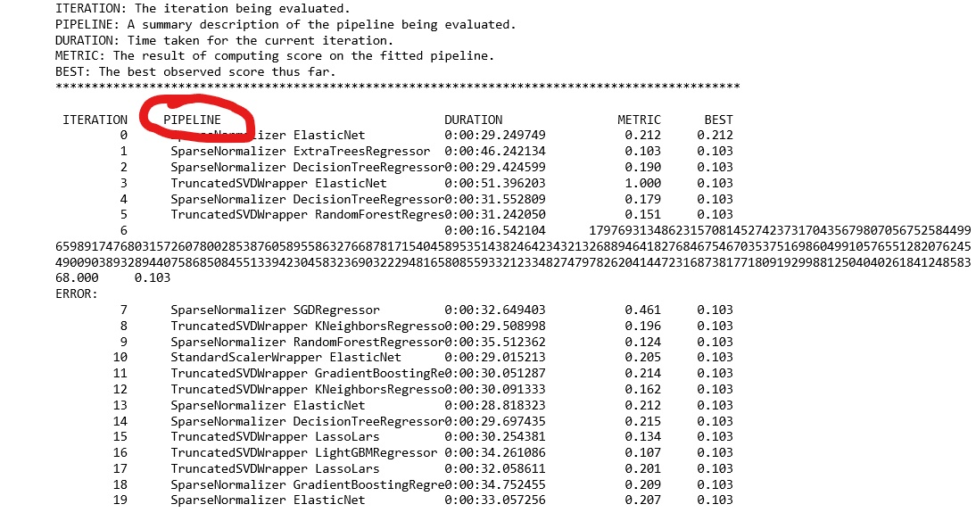
Step – 4 Submit your Automated ML Experiment
Start the experiment to run locally. Define the compute target as local and set the output to true to view progress on the experiment.
Output such as the following appears one line at a time as each iteration progresses. You will see a new line every 10-15 seconds.
from azureml.core.experiment import Experiment
experiment=Experiment(ws, experiment_name)
local_run = experiment.submit(Automl_config, show_output=True)

Slide 17
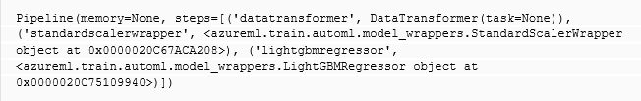
What is a Pipeline?
Pipeline is a set of data processing elements connected in series, where the output of one element is the input of the next one.
It does some of the data transformation (Categorical to numerical).
Select a data preprocessing technique from sklear.preprocessing or sklearn.decomposition
Algorithm
sklearn preprocessing | sklearn decomposition
sklearn.preprocessing.FunctionTransformer | sklearn.decomposition.DictionaryLearning
sklearn.preprocessing.MinMaxScaler | sklearn.decomposition.TruncatedSVD
sklearn.preprocessing.MaxAbsScaler | sklearn.decomposition.PCA
sklearn.preprocessing.OneHotEncoder | sklearn.decomposition.NMF
sklearn.preprocessing.RobustScaler | sklearn.decomposition.sparse_encode

Slide 18
Step 5 – Review Results
Explore the results of automatic training by examining the experiment history.
View the experiment history and see individual metrics for each iteration run.
children = list(local_run.get_children())
metricslist = {}
for run in children:
properties = run.get_properties()
metrics = {k: v for k, v in run.get_metrics().items() if isinstance(v, float)}
metricslist[int(properties['iteration'])] = metrics
import pandas as pd
rundata = pd.DataFrame(metricslist).sort_index(1)
rundata

Slide 19
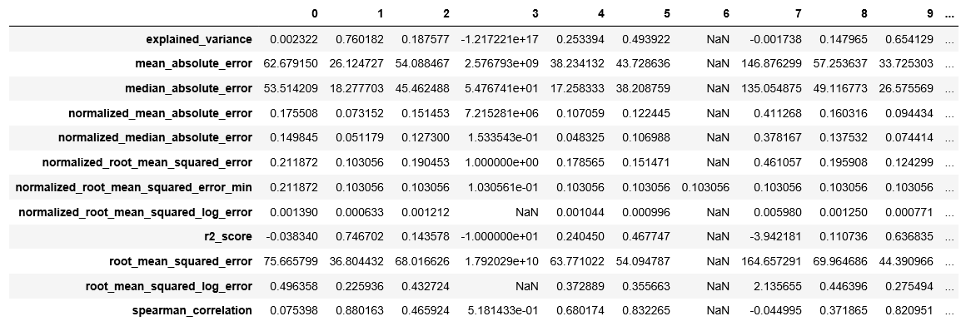
Step 5 – Review Results

Slide 20
Step – 6 Register and deploy model best Model
Use the local_run object to get the best model and register it into the workspace.
You can use the registered model for further Predictions.
Advantages:
We don’t need to Preprocess the data. Some of the basic data preprocessing is done with Azure Automated Machine Learning.
We don’t need to spend lot of the time just to tune hyperparameter values. Azure Automated ML uses collaborative filtering and Bayesian optimization to search an enormous space of possible machine learning pipelines intelligently and efficiently.
We can find the best Algorithm for any Metric.
We can validate and use model of any iteration.
best_run, fitted_model = local_run.get_output() # Register the best Model

Slide 21
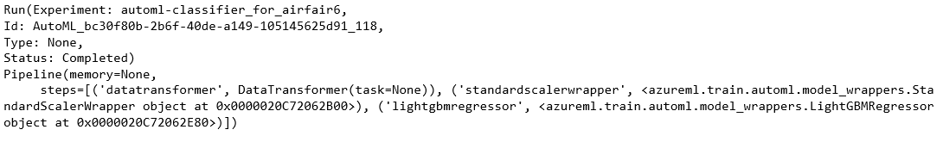
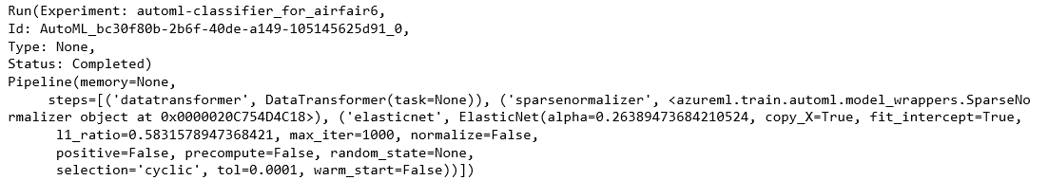
You can select the iteration manually or you can search for the best iteration for specified Metrix
# Exploring the best iteration based on the specified Metrix
lookup_metric = "r2_score"
best_run1, fitted_model1 = local_run.get_output(metric = lookup_metric)
print(best_run1)
print(fitted_model1)
iteration = 0
best_run2, fitted_model2 = local_run.get_output(iteration = iteration)
print(best_run2)
print(fitted_model2)

Slide 22
Manual ML vs Automated ML
Parameters | Manual ML | Automated ML
Price/Cost (Money) | Free | Rs:-500 initially (200rs per day)(Approx)
Price/Cost (Time) | 1 Week | 2 hrs 30 mins
Performance (R2_score) | 0.75 | 0.78
Accuracy (Avg Diff of ticket Price) | 11 | 14
Execution time | 30 sec per iteration | 10-15 secs per iteration
Manual Pre-Processing | Yes | No

Slide 23
Thank You

